Slide 1

JAVA MODELING Language

Slide 2
Download KeY Tool from https://www.key-project.org/dist/2.10.0/key-2.10.0-exe.jar

Slide 3
Table of Contents
JML - Introduction
Unit Specifications
Pre & Post Conditions (requires & ensures)
Design by Contract
Exceptional Post Conditions (signals)
Invariants

Slide 4
Java Modeling Language - Introduction
Formal specification language for Java
to specify behavior of Java classes
to record design & implementation decisions by adding assertions to Java source code, e.g.
preconditions
postconditions
invariants
JML is designed for unit specification.
Goal: JML should be easy to use for any Java programmer.

Slide 5
Unit Specification
Through JML we specify requirements for individual units rather than for the entire system altogether
A unit is the smallest testable part of any software. It usually has one or a few inputs and usually a single output.
In Java, those units are:
methods, where JML specifies the effect of a single method invocation;
classes, where JML merely specifies constraints on the internal structure of an object; and
interfaces, where JML specifies the external behavior of an object.

Slide 6
JML Contd.
To make JML easy to use:
JML specifications are added as comments in .java file,
between /* @ . . . @*/
or after //@
Properties are specified as Java boolean expressions, extended with a few operators (\old, \forall, \result, . . .).
using a few keywords (requires, ensures, signals, assignable, pure, invariant, non null, . . . )

Slide 7
Pre and Post Conditions
Pre- and post-conditions for method can be specified.
/*@ requires amount >= 0;
ensures balance == \old(balance)-amount &&
\result == balance; @*/
public int debit(int amount) {
...
}
Here \old(balance) refers to the value of balance before execution of the method.

Slide 8
Design by Contract Paradigm
Pre- and postconditions define a contract between a class and its clients:
Client must ensure precondition and may assume postcondition
Method may assume precondition and must ensure postcondition
Eg, in the example specs for debit, it is the obligation of the client to ensure that amount is positive.
The requires clause makes this explicit.

Slide 9
Exceptional Post Conditions
Exceptional postconditions can also be specified.
final String AMOUNT_TOO_BIG = “amount > balance ”
int balance;
/* @ requires amount >= 0;
ensures balance == \old(balance)-amount &&
\result == balance;
signals (IOException e) amount > balance &&
balance == \old(balance) &&
e.getReason()==AMOUNT_TOO_BIG; @*/
public int debit(int amount) { ... }

Slide 10
Exceptional Post Conditions
Exceptions are allowed by default, i.e. the default signals clause is
signals (Exception) true;
To rule them out,
Add an explicit signals (Exception) false;
Or use the keyword normal_behavior
/*@ normal_behavior
requires ...
ensures ... @*/

Slide 11
Invariants
Invariants (aka class invariants) are properties that must be maintained by all methods, e.g.,
public class Wallet {
public static final short MAX_BAL = 10000;
private short balance;
/*@ invariant 0 <= balance && balance <= MAX_BAL; @*/
… }
Invariants are implicitly included in all pre- and postconditions.
Invariants must also be preserved if exception is thrown!
They can however be violated during method execution

Slide 12
Invariants
Invariants document design decisions, e.g.,
public class Directory {
private File[] files ;
/*@ invariant files != null &&
(\forall int i; 0 <= i && i < files.length; ;
files[i] != null && files[i].getParent() == this); @*/
Making them explicit helps in understanding the code.

Slide 13
JML Keywords

Slide 14
Contents
non_null
nullable
assignable
Pure
Visibility Keyword – spec_public

Slide 15
non_null
Many invariants, pre- and postconditions are about references not being null.
non_null is a convenient short-hand for these.
public class Directory {
private /*@ non_null @*/ File[] files;
void createSubdir(/*@ non_null @*/ String name){ … }
Directory /*@ non_null @*/ getParent() { ... }
}

Slide 16
Contd.
non_null is default.
Previous example can be written as follows and will imply the same specification.
public class Directory {
private File[] files;
void createSubdir(String name){ … }
Directory getParent() { ... }
}

Slide 17
nullable
To prevent variables to be non_null by default nullable keyword is used.
public class Directory {
private /*@ nullable @*/ File[] files;
void createSubdir(/*@ nullable @*/ String name){ … }
Directory /*@ nullable @*/ getParent() { ... }
}

Slide 18
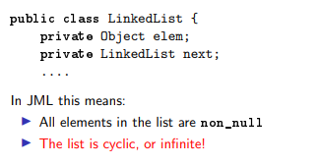
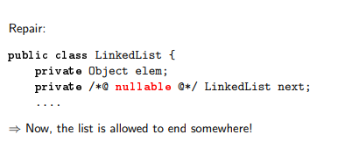

Slide 19
assert
An assert clause specifies a property that should hold at some point in the code, e.g.,
if (i <= 0 || j < 0) { ... }
else if (j < 5) {
//@ assert i > 0 && 0 < j && j < 5;
... }
else {
//@ assert i > 0 && j > 5;
... }

Slide 20
assignable
Frame properties limit possible side-effects of methods.
/*@ requires amount >= 0;
assignable balance;
ensures balance == \old(balance)-amount; @*/
public int debit(int amount) { ...
debit can only assign to the field balance.
Default assignable clause: assignable \everything.

Slide 21
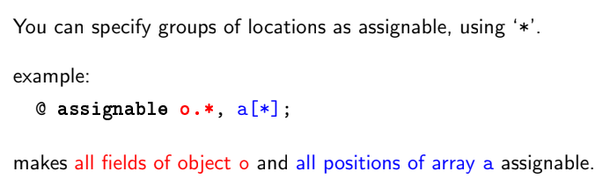

Slide 22
pure
A method without side-effects is called pure.
public /*@ pure @*/ int getBalance(){...
Directory /*@ pure non_null @*/ getParent(){...
Pure method are implicitly assignable \nothing.
Only pure methods can be used in specifications.

Slide 23
Visibility
JML supports the standard Java visibilities:
Specs of public methods can not refer to private fields.
public int pub;
private int priv;
//@ requires i <= pub;
public void pub1 (int i) { ... }
//@ requires i <= pub && i <= priv;
private void priv1 (int i) ...
//@ requires i <= pub && i <= priv; //WRONG !!
public void pub2(int i) { ... }

Slide 24
spec_public
Keyword spec_public loosens visibility for specs.
Private spec_public fields are allowed in public specs, e.g.:
public int pub ;
private /*@ spec_public @*/ int priv;
//@ requires i <= pub && i <= priv; //OK
public void pub2(int i) { ... }

Slide 25
Thank you!

